Slide 1
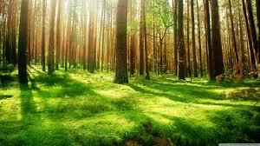
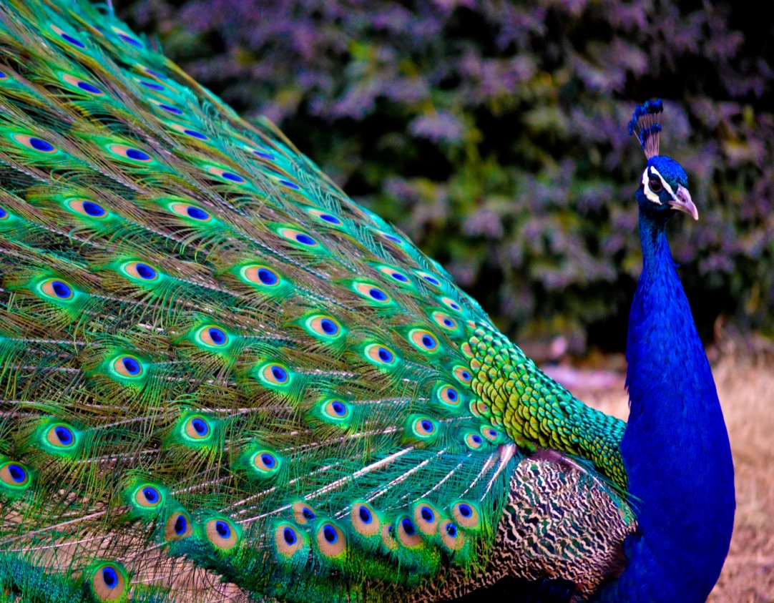
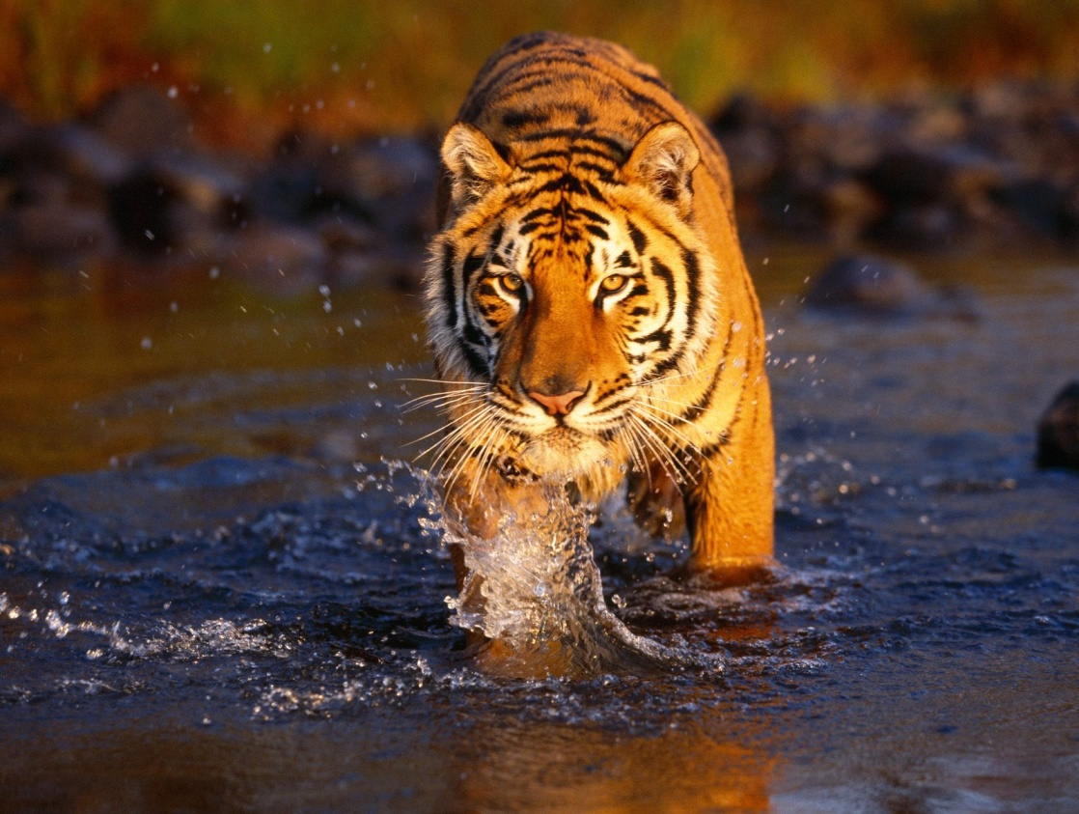
MahaWild
Group Members:-
Swapnil Gade.
Deepak Awal.
Aditya Dhopade.
Lokesh Alli.
Group :- O.
Guide:- Mrs. K. A. Khedikar.

Slide 2

Project Idea !!!
To develop an mobile application for mapping wildlife sanctuaries/national parks/Bird sanctuaries of Maharashtra with requisite travel information useful for tourists.

Slide 3
Which features are lagging in current apps ??
Plan To Visit
User Interface
Information of Sanctuary
Nearby Attractions

Slide 4
Characteristics of our project
More user friendly
Information easily available to the user regarding sanctuary
Help on the way
Current Weather Information
Interactive images
Make a trip

Slide 5
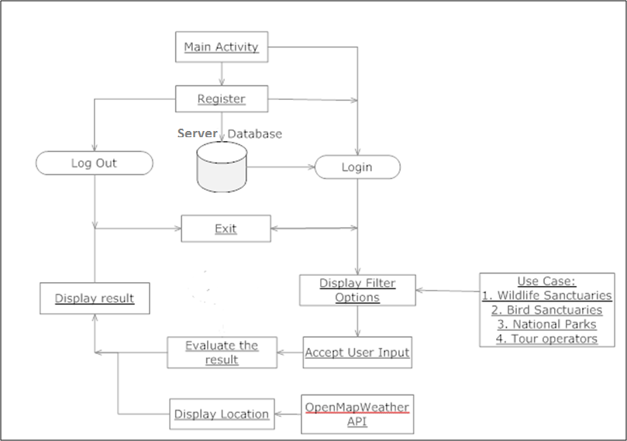
System Architecture

Slide 6
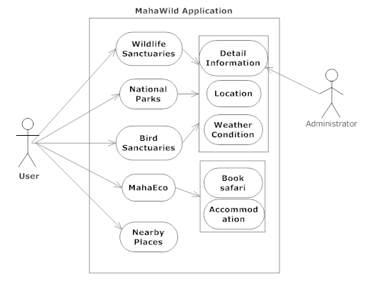
Working

Slide 7
Requirements
1. For Android Users:
a) Hardware required :
RAM : minimum 512MB
Memory : minimum 20MB
b) Software required :
OS : API level Jellybean or higher

Slide 8
2. For Development :
a) Hardware required :
RAM : minimum 2GB
Hard Disk : minimum 100GB
b) Software required :
Android Studio IDE

Slide 9
c) Languages Used:
Java
XML

Slide 10
Work Distribution
1. Data Collection:
Lokesh Alli
Deepak Awal
Swapnil Gade
2. Designing:
Aditya Dhopade
Lokesh Alli

Slide 11
3. Coding & Testing:
Swapnil Gade
Deepak Awal
Lokesh Alli
Aditya Dhopade

Slide 12
4. Maintenance:
Deepak Awal
Aditya Dhopade

Slide 13
THANK YOU

